Slide 1
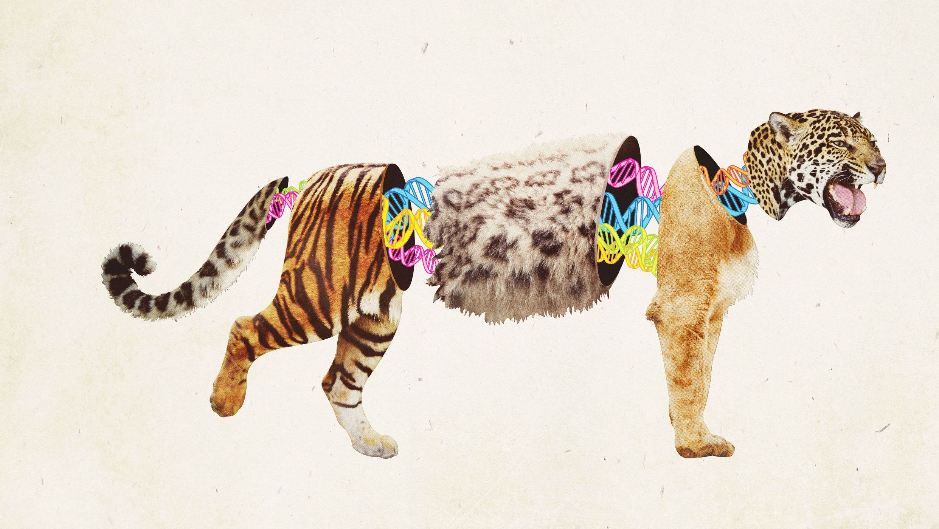
ANIMAL HYBRIDS

Slide 2
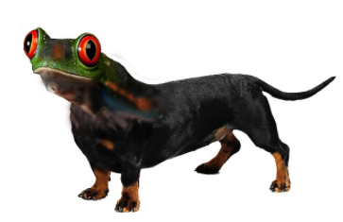
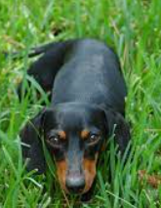
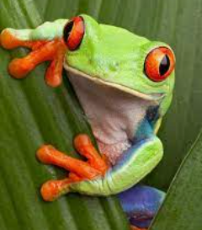
WHAT 2 ANIMALS CAN YOU SEE?
THIS IS A DROG.
A DOG
AND A FROG

Slide 3
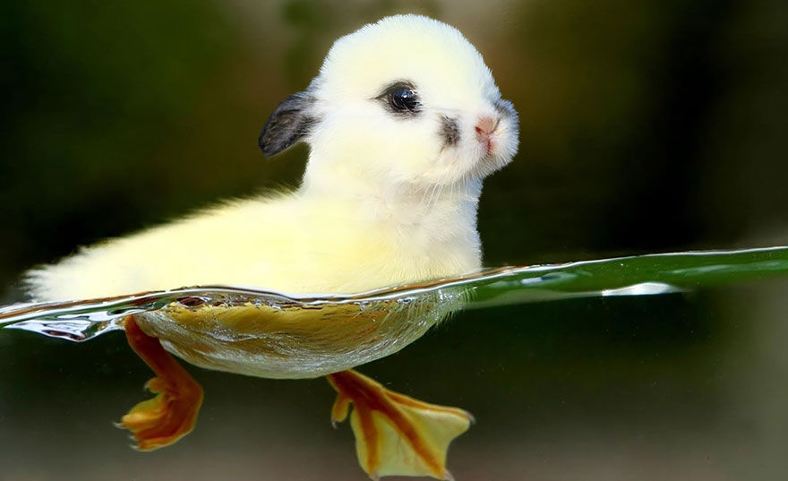
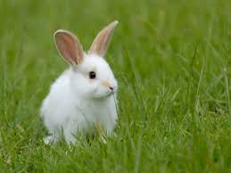
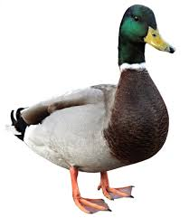
WHAT 2 ANIMALS CAN YOU SEE?
THIS IS A RABUCK.
A RABBIT
AND A DUCK

Slide 4
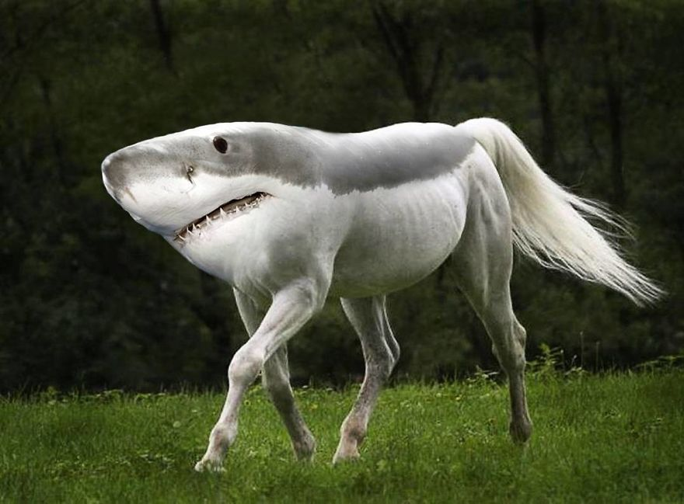
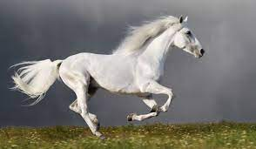
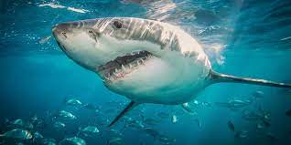
WHAT 2 ANIMALS CAN YOU SEE?
THIS IS A SHARSE.
A SHARK
AND A HORSE

Slide 5
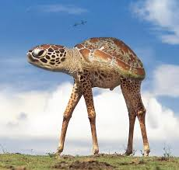
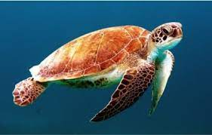
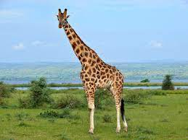
WHAT 2 ANIMALS CAN YOU SEE?
THIS IS A TURAFFE.
A TURTLE
AND A GIRAFFE

Slide 6
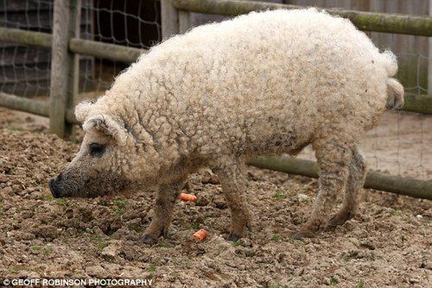
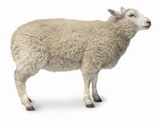
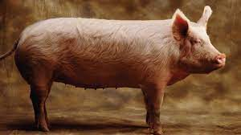
WHAT 2 ANIMALS CAN YOU SEE?
THIS IS A SHIG.
A PIG
AND A SHEEP

